Slide 1



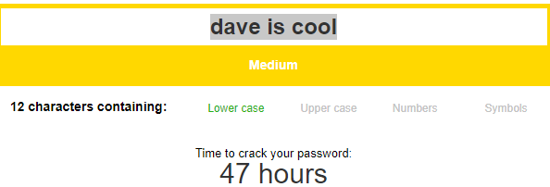


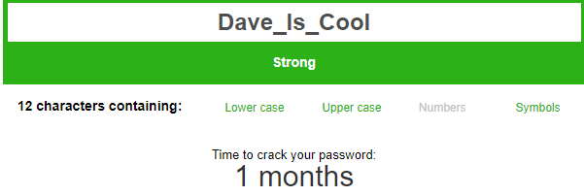
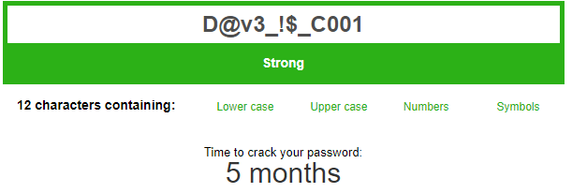
The Issues:
Vulnerability of people Online
Not aware of dangers
Weak Passwords
Doubts of internet security/integrity
Forgetfulness
The Fix:
Assist User online safety via Navigation
Web Page -> “Take their Hand” approach
Password System -> Ensures Secure password of user
MIC/MIR -> Helps Remember
Password System
Web Page
One Place for EVERYTHING
User Can access website via icons like:
Memorable Information Creator and Retriever (MIC/MIR)
Basic:
Manipulates User string to implement Snake_Case
Forgetful?
Need to take Notes?
Keep Password Hints in one Place
Designed to be as like mobile OS.
Intuitive and Easy to use.
Extreme:
Data scrambled using Cipher Text encryption.
A-> @
i->!
Hints are sent to a Database and only accessible via website
Database
Each user inputs website name and hint. Can be called via Object name
Data Is saved and retrieved by Unique User ID that is allocated to each user
Background Designed By Freepik

